Slide 1
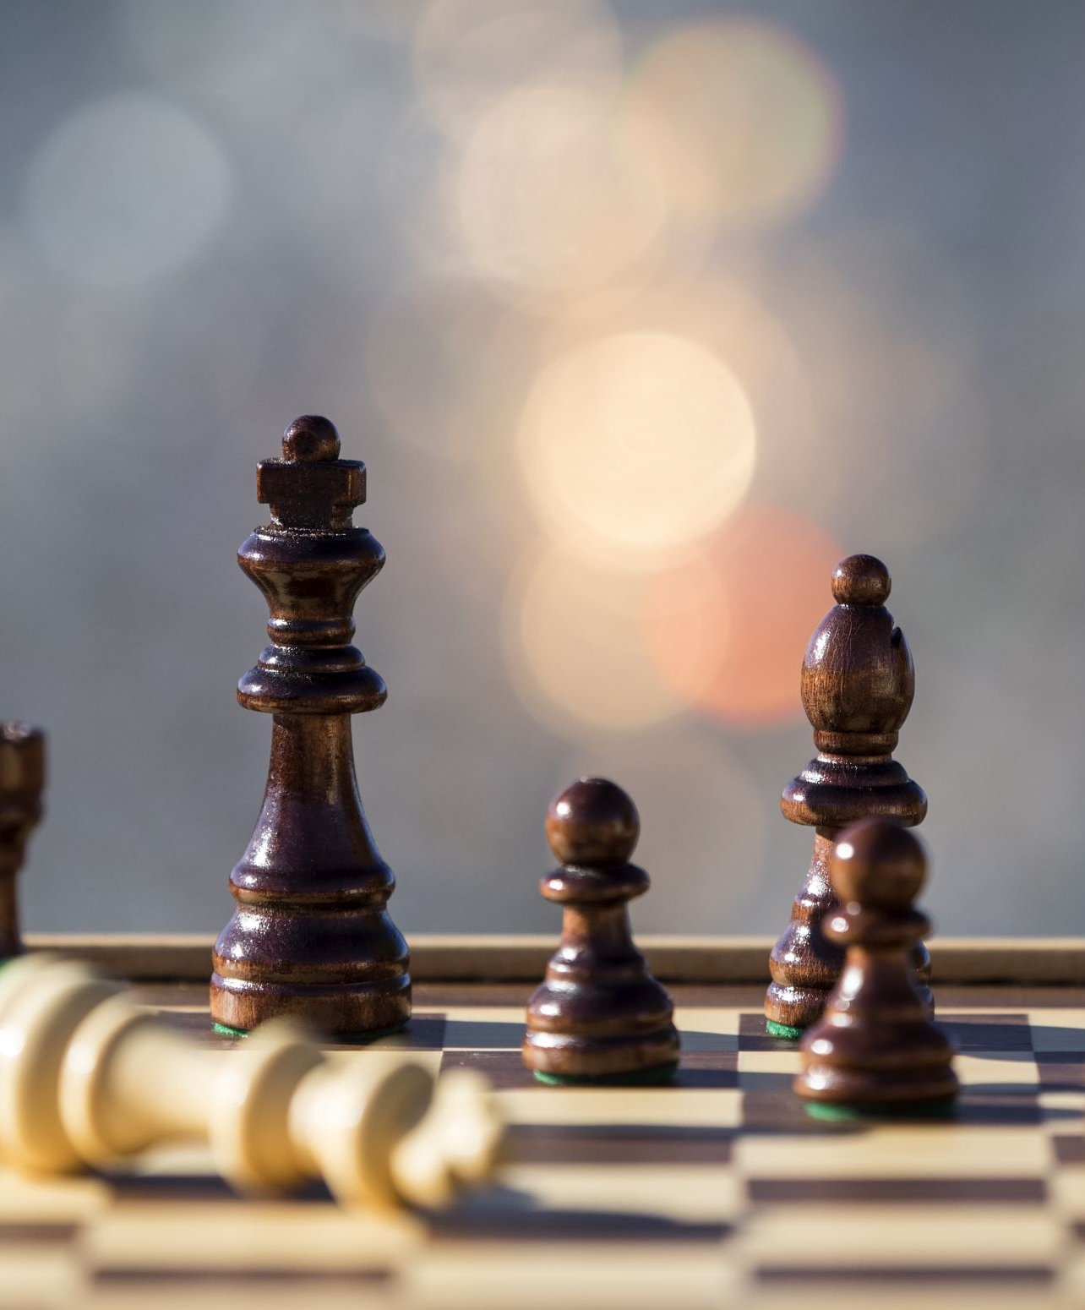
Self Learning Chess Engine
Using Neural Network and Minimax algorithm.
Stanley

Slide 2
Overview
I plan to create a chess application along with its chess engine. I want to create a self-learning chess engine that takes advantage of machine learning to teach itself how to play chess and find optimal moves.
Combining Neural Networks and Monte Carlo Tree Search
It will allow for a person to play with the AI in which the AI will get better as it gets used to the player’s patterns.
I am building this project for me as it provides an opportunity to explore areas I am interested in. The final product would be used as entertainment and teach people who likes chess.

Slide 3
Usage and Features
Because there is thousands of possibilities in chess at any given time, using neural network is optimal.
Database, “memory” of actions and games played.
The application will be simple with an interactive chess user interface. This is the application that the user will interact with. There will be a chess board on the left and a collapsable sidebar for a difficulty selector.
The application will come with 2 separate programs, 1 program for the chess interface and a separate chess engine program to access the interface.

Slide 4
Justification
I love video games and machine learning
This project will be a cumulation of what I have learned in several classes throughout my previous semesters such as:
  Algorithms and Analysis (CMSI 2130)
  Artificial Intelligence (CMSI 3300)
  Probability and Statistics (MATH 361)
  Database Systems (CMSI 3520)
  Also, Cognitive Systems Design (CMSI 4320) which I am currently taking this semester.
Practical application of complex theories
Notes:
Offers practical application and implementations of complex theories previously learned such as regressive search, neural networks, monte carlo tree search, managing database in SQL, etc.

Slide 5
Existing Projects
Gary Linscott et al. https://lczero.org/ Leela Chess Zero – Open source neural network based chess engine.
David Silver et al. https://deepmind.google/blog/alphazero-shedding-new-light-on-chess-shogi-and-go/ Alpha Zero – Self-learning algorithm for multiple games developed by DeepMind.
Joona Kiiski et al. https://github.com/official-stockfish/Stockfish StockFish – UCI chess engine that analyzes chess positions and computes the optimal moves.
Matthew Voss. https://mpvoss.github.io/chess.html – exploring concepts of AI integration in chess.
Andreas Stockl https://andreasstckl.medium.com/writing-a-chess-program-in-one-day-30daff4610ec – Basic chess program built in Python.

Slide 6
Software and Hardware
Combines Neural Network and Monte Carlo Tree Search
Python
C++
PyTorch, TensorFlow
Processing power for simulations will be done using my PC.
  Radeon RX 9060
  AMD Ryzen 5 7600x
  32GB Ram

